Slide 1

SwiftieBot
Group – 1:
Christopher Colley
Preethi Jerripothula
Hari Shanker Reddy Madana
Sai Madhan Muthyam
Sofia Rajan
Hrushikesh Sriramaneni

Slide 2
Information Retrieval with Chatbots
Introducing our innovative chatbot project aimed at streamlining information retrieval processes.
Leveraging cutting-edge technology to extract data from Wikipedia articles.
Transforming user interactions through natural language processing and conversational AI.
Exploring the versatility of chatbots beyond celebrity queries to enhance user engagement across various domains.

Slide 3
Use Cases
Objective: Develop a chatbot to extract data from a Taylor Swift Wikipedia article and respond to user inquiries.
Versatility: Beyond celebrity inquiries, the chatbot guides users on websites, provides direct answers, and saves customer time.
Benefits: Streamlines information retrieval and enhances user experiences with natural language processing and conversational AI technologies.

Slide 4
Methodology: Corpus Used
spaCy: en_core_web_sm
Nltk: stopwords
Bs4: BeautifulSoup (used to scrape a website)

Slide 5
Methodology: Data Preparation and cleansing
Scrape Website
Convert to lower
Remove non-alphanumeric characters except commas and periods
Tokenize the Text
Remove Stop Words
Chatbot
Tokenize
Stop Word Removal
Cosine Similarity
TF-IDF Vectorization

Slide 6
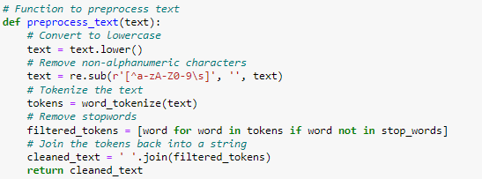
Methodology: Python Code
1. Preprocessing the scraped text:

Slide 7
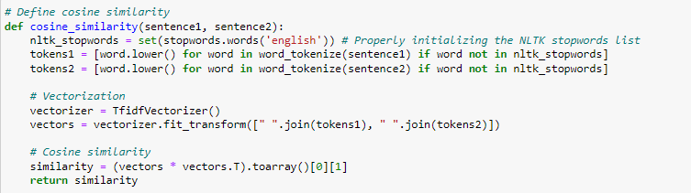
Methodology: Python Code
2. Vectorization and Cosine:

Slide 8
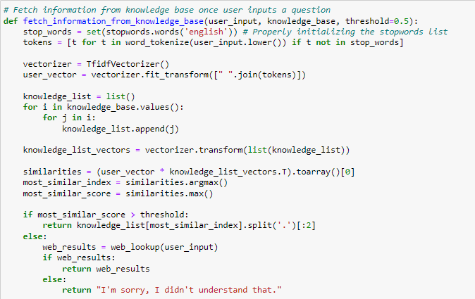
Methodology: Python Code
3. Fetch information from knowledge base

Slide 9
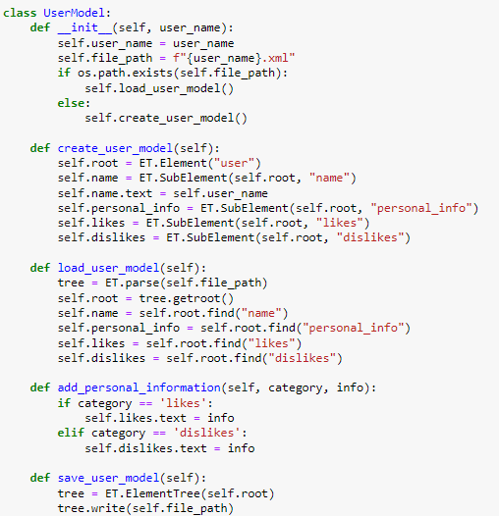
Methodology: Python Code
4. UserModel

Slide 10
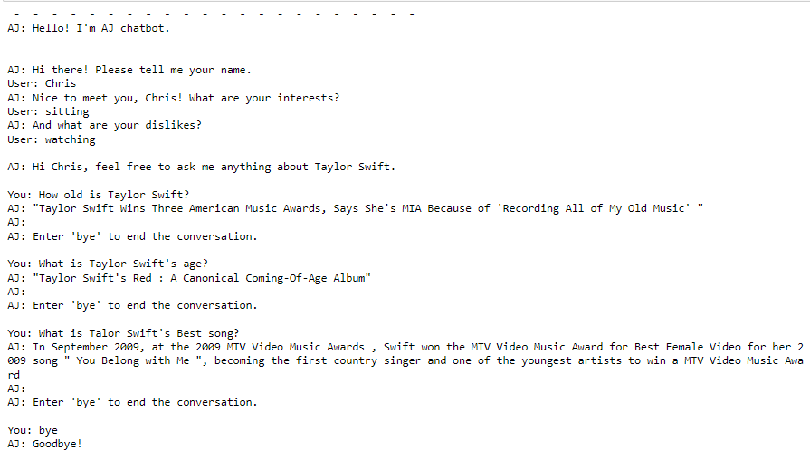
Testing the Code

Slide 11
Conclusion
Data Collection: Utilizes knowledge scraped from Wikipedia and Google searches.
Tokenization: Extracts important keywords for effective search.
User Engagement: Collects user preferences and allows direct questioning, aiding in data gathering.
Limitless Applications: Versatile tool for diverse business tasks and operations.

